Slide 1
JAVA Swing
Aka working with desktop GUI library in java

Slide 2
JAVA Swing
What is
Swing is an API for providing a graphical user interface (GUI aka gooyi) for Java programs.
a platform-independent, GUI framework for Java
"model-view-controller"

Slide 3
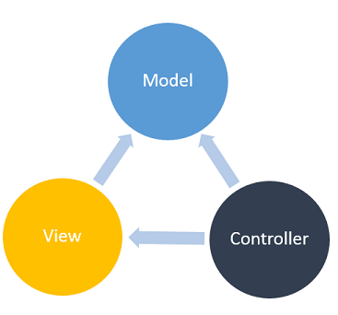
MVC
"model-view-controller"
Swing uses MVC pattern internally within its own code logic

Slide 4
MVC
Model - Model represents an object carrying data. It can also have logic to update controller if its data changes.
View - View represents the visualization of the data that model contains.
Controller - Controller acts on both model and view. It controls the data flow into model object and updates the view whenever data changes. It keeps view and model separate.
Click for more info on how swing uses MVC

Slide 5
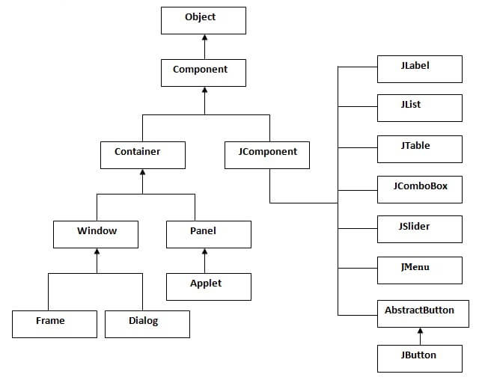
Swing Class hierarchy

Slide 6
JComponent
all Swing components whose names begin with "J" descend from the JComponent class.
For example, JPanel, JScrollPane, JButton, and JTable all inherit from JComponent.
With the exception of top-level containers

Slide 7
JFrame
With the exception of top-level containers
The javax.swing.JFrame class is a type of container which inherits the java.awt.Frame class. JFrame works like the main window where components like labels, buttons, textfields are added to create a GUI.

Slide 8
Lets jump into code

Slide 9
Event Handling
What is an Event?
Change in the state of an object is known as Event, i.e., event describes the change in the state of the source.
How Events are generated?
as a result of user interaction with the graphical user interface components.

Slide 10
Event Handling
Event Handling is the mechanism that controls the event and decides what should happen if an event occurs
Event Source
Event Listener aka handler
The source is an object on which the event occurs. Source is responsible for providing information of the occurred event to it's handler
The listener is responsible for generating a response to an event.
it is also an object that waits till it receives an event. Once the event is received, the listener processes the event and then returns.

Slide 11
Event Handling
How the “Handling” works?
Step 1 − The user clicks the button and the event is generated.
Step 2 − The object of concerned event class is created automatically and information about the source and the event get populated within the same object.
Step 3 − Event object is forwarded to the method of the registered listener class.
Step 4 − The method is gets executed and returns.

Slide 12
Lets jump into code one more time

